Slide 1
Univariate Analysis: Introduction
Notes:
Hello and welcome to module 2 of the data mining track!
Today we will be exploring the topic of Univariate Analysis!

Slide 2

Module 2 Instructor
Eric Cui
Dual Degree: MD / PSM BMHI
University of North Carolina at Chapel Hill
eric_cui@med.unc.edu
Office hours
Notes:
Before we begin, I would like to introduce myself.
My name is Eric Cui and I will be your instructor for this module.
I am a dual degree student at UNC Chapel Hill. I am pursuing an MD from the UNC school of medicine and have finished my second year.
I am also pursuing a master’s degree in biomedical and health informatics.
If you have any questions for the course, please feel free to email me.
There will also be pre-specified office hours held this summer where you can speak to me via video call if you prefer.
Now lets jump right in!

Slide 3
What is Univariate Analysis?
Univariate analysis
An analysis involving a single variable
Uni = “One”
Bivariate analysis
Analysis involving two variables
Multivariate analysis
Analysis involving many variables
Each can provide different types of information!
Notes:
So….what the heck even is Univariate Analysis?
Well lets break the term down.
Uni- means “one”, while “variate” means variable
Putting it together we can conclude that Univariate Analysis is an analysis of a single variable
Using this approach we can also understand several other terms you will hear throughout future modules and beyond if you continue your data science education
These include bivariate analysis, which is the analysis of two variables and multivariate analysis, which is the analysis of many variables (3 or more)
Each different analysis has its own techniques and provide different kinds of information

Slide 4
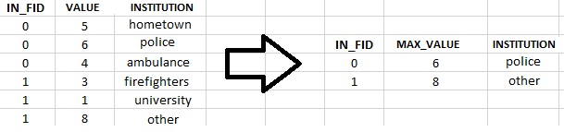
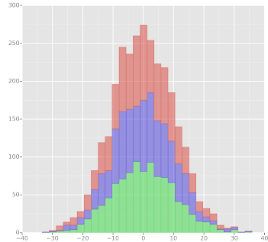
Outline
Univariate Data Visualization
Variable Types
Summary Statistics
Variable
Categorical
Continuous
Notes:
In this module, we will be exploring 3 facet of univariate anlaysis.
First, we will be breaking a variable down by which type of variable it is. This will determine what kind of univariate analysis we conduct for that variable.
Next, we will be exploring summary statistics, which help us get a 10,000 foot view of the data
Finally, we will learn about univariate data visualization which will allow us to quickly ascertain specific information about a variable visually…in other word we will be actually seeing our data and how it can take form!
Throughout this module you will have the chance to both engage with these concept conceptually (through the module videos) and then get a chance to get your hands dirty with each of these concepts through the module notebooks.
Lets keep going.

Slide 5
End of 1st Video for Data Mining Module 2

Slide 6
Univariate Analysis: Variable Types
Notes:
So, first up for module 2 is exploring variable types.

Slide 7
Variable Types
Why?
Variable type determines what can be done to that data
Will alter the type of analysis done
Two Types for this Module
Categorical
Continuous
Notes:
Why is this important?
Well, variable type will tell what we can and can’t do to our data. This will subsequently change the kind of analysis we can do for our variable.
In other words, variable type is critical because it will completely determine the type of univariate analysis we can perform for our variable.
No in terms of variable type, there are two distinct categories, categorical and continuous variables.
There are more detailed and nuanced categories that people have come up with, however that is beyond the scope of this course.
Separating variables into these two categories will serve as a good starting point.

Slide 8
Categorical Variables
Variables that contain a limited group of categories
A person’s biological sex
Male/Female
Cancer Staging
Stage I/II/III/IV
Notes:
So what is a categorical variable?
A categorical variables is simply a variable which contains a limited number of categories. In other words, they have a finite number of categories.
One example is a person’s biological sex, this would likely only be two categories, male or female
Another example would be cancer staging, this would likely only be a limited number of categories again, for instance there may only be four categories, stage 1, stage 2, stage 3, and stage 4
What these two example share in common is they have a limited number of categories

Slide 9
Continuous Variables
These are numeric variables. They can have potentially an infinite number of possible values between two pre-specified values.
Age
Any number between 0 – 125
Weight
Any number between 0 – 600
Note: Upper and lower limits are arbitrary. In this case, limits are based on what is considered to be realistically possible.
Notes:
On the other end are continuous variables
These are essentially numeric variables. Unlike categorical variable, these can take on an unlimited number of possible categories or values. Commonly the range of value they can take on is limited by 2 pre-specified values
One example is age, a dataset may have a person’s age in year, this variable could likely take on any value as long as it’s a realistic age (say between 0 years old and 125 years old)
Another example is weight, a dataset may record a person’s weight as a number (in pounds) anywhere between 0 and 600
Although each has a different range of value, they could potentially take on an infinite number of values

Slide 10
Question 1
In our dataset out primary outcome is whether a patient died or not in the first 24 hours. This outcome is represented in the variable “hospital_death”. Is this variable a continuous or categorical variable?
It is a categorical variable
In our dataset, we have information about how old each patient is. This outcome is represented in the variable “age”. It this variable a continuous or categorical variable?
It is a continuous variable
Notes:
So lets take what we learned and apply it.
In the dataset we will be examining, we want to know whether a patient died in the first 24 hours. This outcome is represent with the variable hospital_death. Is this a continuous or categorical variable.
It is categorical, this is because this variable can only take on two categories, deceased or not deceased
Our data also contains information about a person’s age. Is this a continuous or categorical variable?
- It is a continuous variable, this is because this variable can take on any number (between a realistic range)

Slide 11
End of 2nd Video for Data Mining Module 2

Slide 12
Univariate Analysis: Summary Statistics
Notes:
We will now be exploring summary statistics

Slide 13
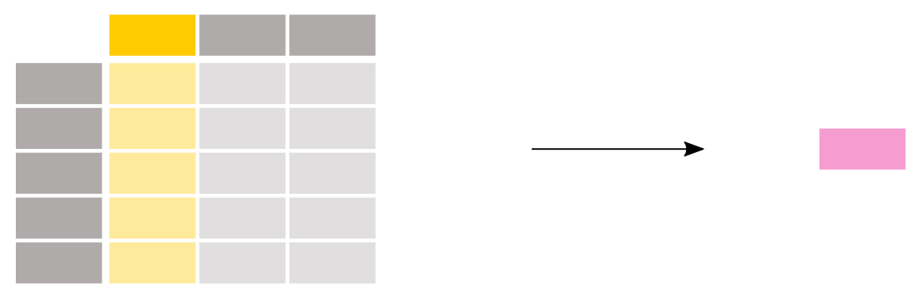
Summary Statistics
Information that generally describes your data. Summary statistics will summarize your observations.

Slide 14
Continuous Variable Summary Statistics
Median: the point on a scale that separated a distribution of scores into two groups; one half of the data are above the median and the other half are below the median
Mean: the arithmetic mean; or the sum of the scores divided by the number of scores

Slide 15
Continuous Variable Summary Statistics (cont…)
Example: 1, 2, 2, 3, 4, 7, 9
Median
{1, 2, 3, 4, 5, 6, 7, 8, 9
(4+5) / 2 = 4.5
Mean
(1+2+2+3+4+7+9)/7 = 4

Slide 16
Continuous Variable Summary Statistics (cont…)
Outliers!
Data that differs significantly from others observations
Can be extremely high or extremely low
Example: 1, 2, 2, 3, 4, 7, 900
Median: 4.5
Mean: 131.3
Median better for data that is skewed or has many outliers

Slide 17
Categorical Variable Summary Statistics
Frequency
The number of observations
Percent
The percentage of that particular category for a variable
Insert table of the hospital death variable

Slide 18
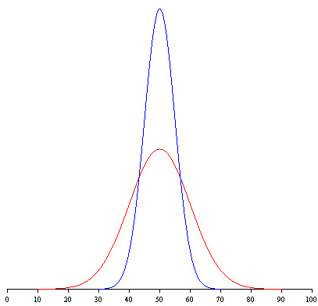
Variability

Slide 19
Variability
Variability show how “spread out” a continuous variable is
Standard deviation: variability measure for means
Interquartile Range (IQR): variability measure for medians
Range: the difference between the largest score and the smallest score.
Notes:
Measures of variability address the question, “How spread out are the scores from one another?”

Slide 20
Question 2
A critical part of any clinical experiment is understanding your patients. Say we have a 10 patient cohort with the following ages in years below.
18, 38, 53, 27, 68, 44, 86, 63, 54, 68
Please calculate the appropriate summary statistics for this cohort

Slide 21
End of 3rd Video for Data Mining Module 2

Slide 22
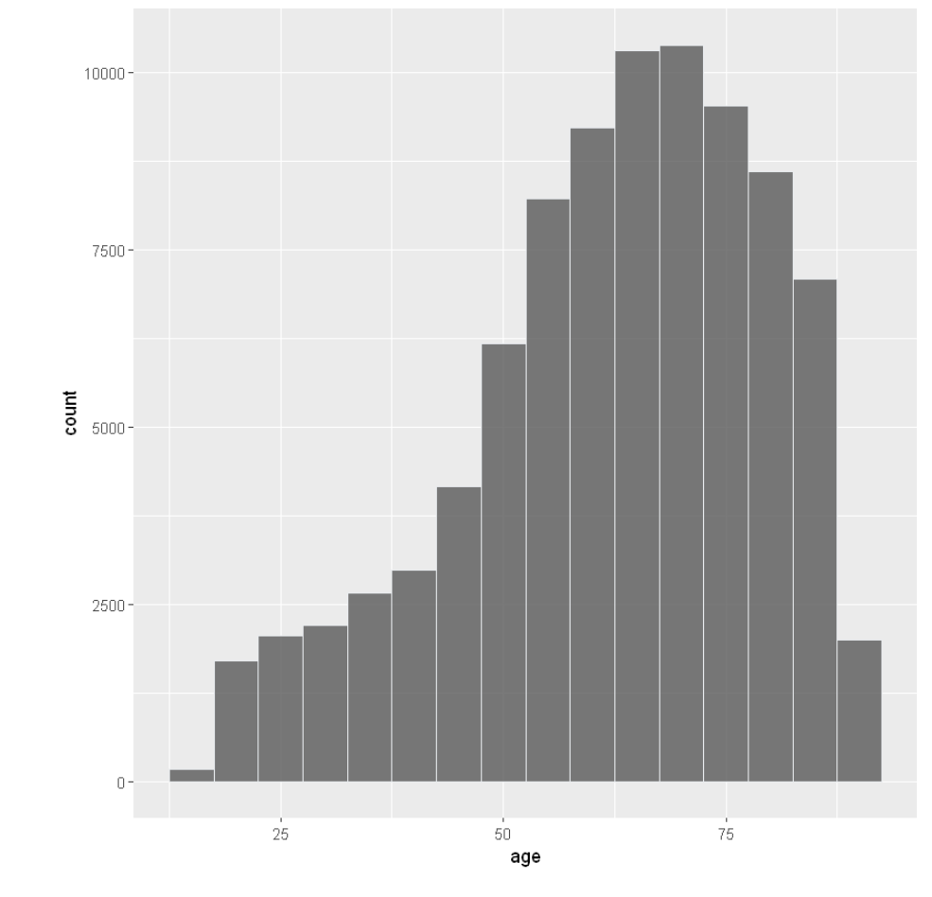
Histogram

Slide 23
Histogram (Cont.)
Data visualization for continuous variables
Graphical display of data using bars of different heights.
Each bar groups numbers into ranges.
Taller bars show that more data falls in that range.
Smaller bars show that less data falls into that range
A histogram displays the shape and spread of continuous data.

Slide 24
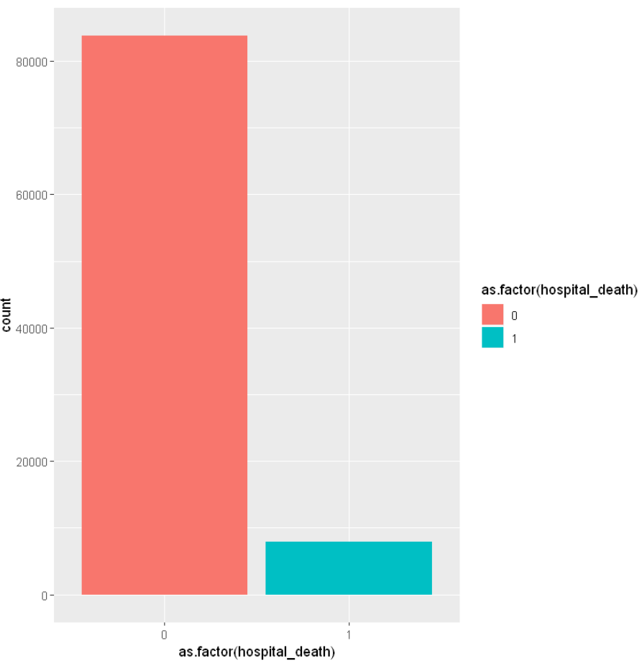
Bar Plot

Slide 25
Bar Plot (Cont.)
Data visualization for graphical variables
Each bar represents a category
Taller bars show that more data falls in that category
Smaller bars show that less data falls into that category

Slide 26
End of 4th Video for Data Mining Module 2

Slide 27
Univariate Analysis Exercise

Slide 28




We are grateful to the following organizations for their support:

Slide 29
Interested in an MPS or a Ph.D. in digital health? Drop us a line: chip@unc.edu.

Slide 30
End of 5th Video for Data Mining Module 2

